Slide 1
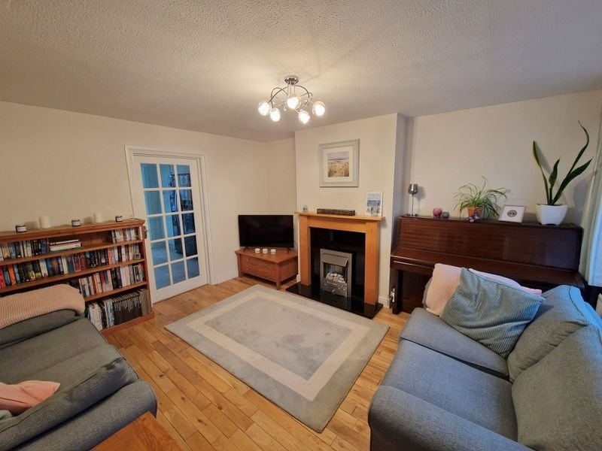
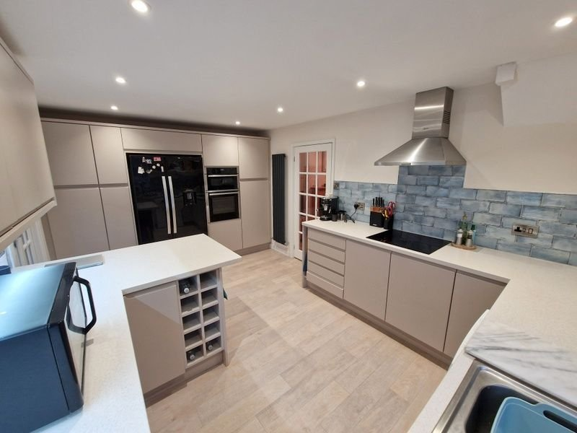
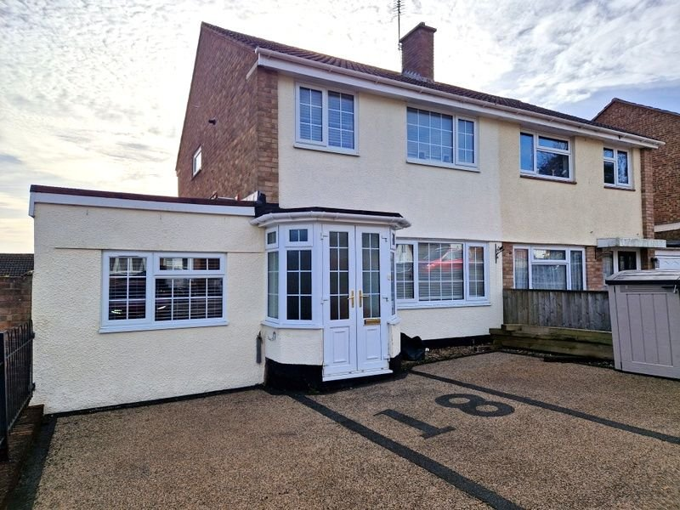
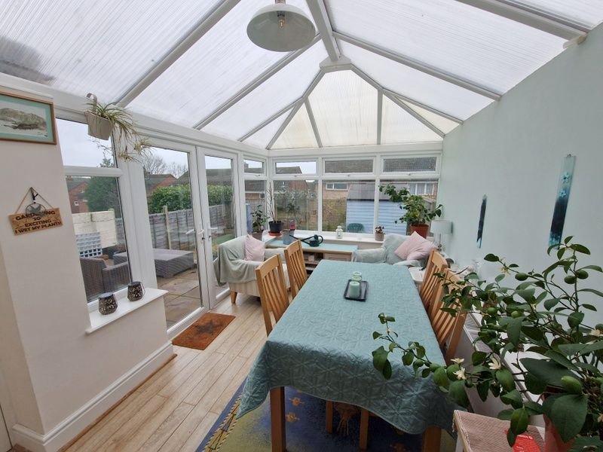
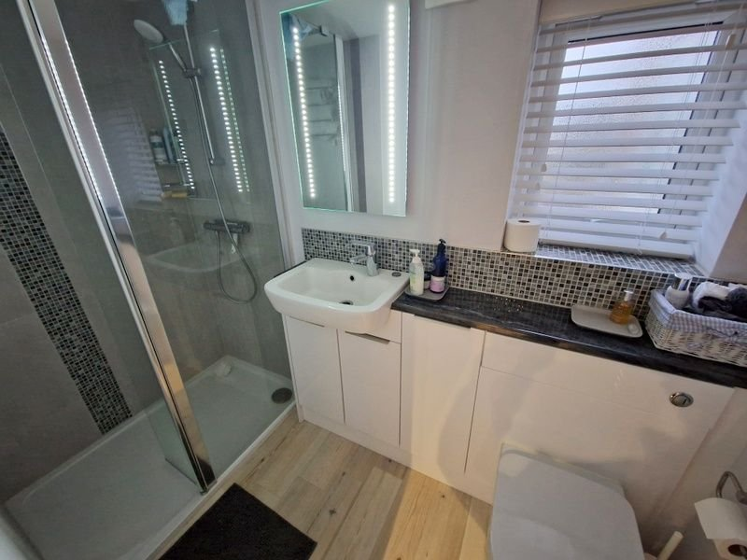
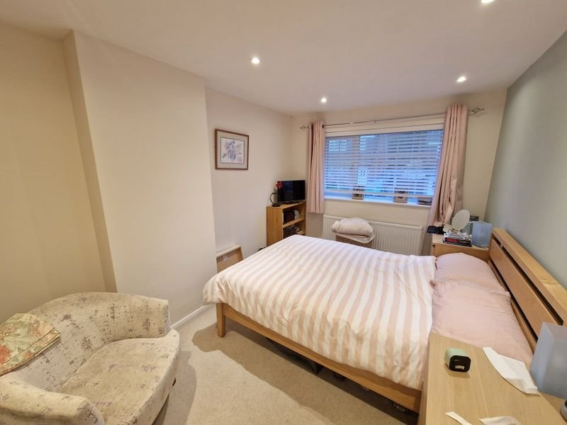
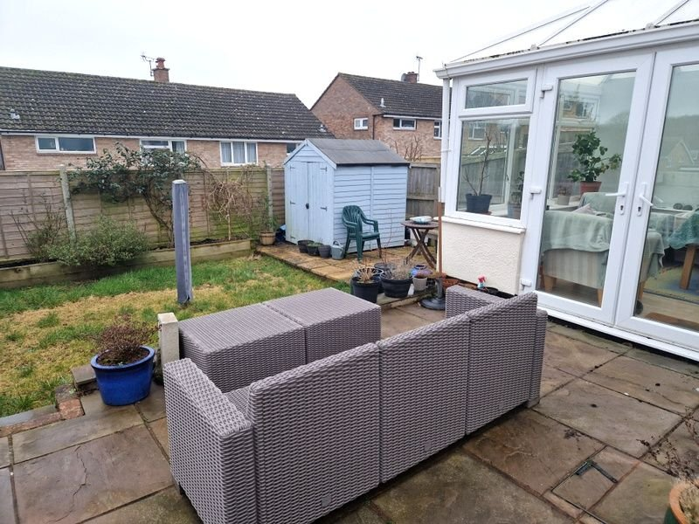
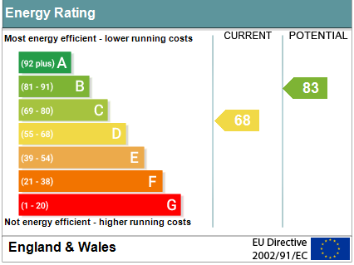
www.pennys.net
18 Little Meadow, Exmouth, EX8 4LU
PRICE £365,000
TENURE Freehold
A Superb Semi Detached Four Bedroom House Located In A Popular And Convenient Location
Reception Hall • Ground Floor Bedroom Four With En-Suite Shower Room/WC •
Lounge • Stunning Open Plan Kitchen/Breakfast/Dining Room • Conservatory •
Three First Floor Bedrooms & Bathroom/WC •
Stone Resin Driveway Providing Ample Parking •
Sunny Aspect Enclosed Rear Garden • Gas Central Heating & Double Glazed Windows •
Super Family Home •
Pennys Estate Agents Limited for themselves and for the vendor of this property whose agents they are give notice that:- (1) These particulars do not constitute any part of an offer or a contract. (2) All statements contained in these particulars are made without responsibility on the part of Pennys Estate Agents Limited. (3) None of the statements contained in these particulars are to be relied upon as a statement or representation of fact. (4) Any intending purchaser must satisfy himself/herself by inspection or otherwise as to the correctness of each of the statements contained in these particulars. (5) The vendor does not make or give and neither do Pennys Estate Agents Limited nor any person in their employment has any authority to make or give any representation or warranty whatever in relation to this property.
PENNYS ESTATE AGENTS
2 Rolle House, Rolle Street, Exmouth, Devon, EX8 2SN
Tel: 01395 264111 EMail: help@pennys.net

Slide 2
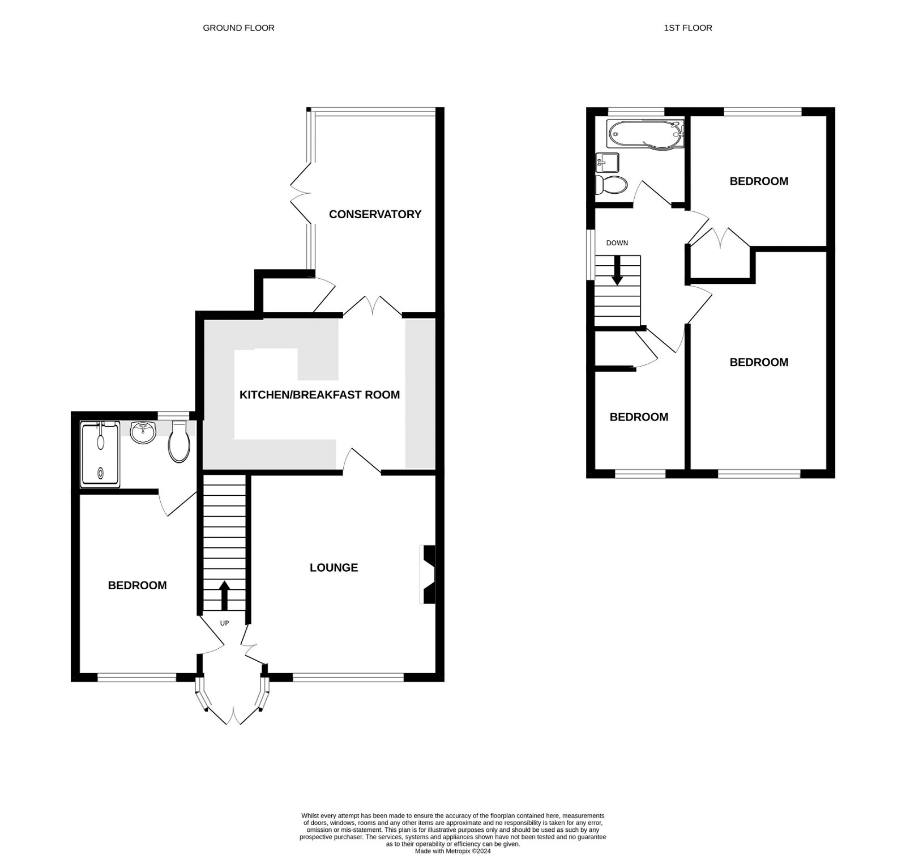
18 Little Meadow, Exmouth, EX8 4LU
THE ACCOMMODATION COMPRISES: uPVC front bay with double doors to: RECEPTION HALL: Tiled entrance floor leading to solid wood flooring; radiator; stairs to first floor landing; electric consumer unit; glass panelled double doors to: LOUNGE: 3.96m x 2.87m (13'0" x 9'5") uPVC double glazed window to front aspect; radiator; wood fire surround housing living flame pebble effect electric fire; television point; wooden floor; part glazed door to: KITCHEN/BREAKFAST/DINING ROOM: 4.57m x 3.12m (15'0" x 10'3") A superb open plan room comprising of a range of pattern worktop surfaces extended to provide a breakfast bar area with cupboards, drawer units and dishwasher space beneath; inset one and a quarter bowl single drainer sink unit; tiled surrounds; wall mounted cupboards with concealed lighting under; inset induction hob with chimney style extractor hood over; built-in oven and grill with cupboards above and below; space for an American style fridge freezer with cupboards over and to side; ceiling LED spotlighting; uPVC double glazed window to side aspect; upright radiator; wood effect flooring; double doors to: CONSERVATORY: 4.22m x 2.59m (13'10" x 8'6") A fine addition with radiator; uPVC double glazed window and double doors to REAR GARDEN; door to UTILITIES CUPBOARD with plumbing for an automatic washing machine and space for tumble dryer; wood effect flooring. GROUND FLOOR BEDROOM FOUR: 3.71m x 2.44m (12'2" x 8'0") uPVC double glazed window to front aspect; radiator; wood effect flooring; recess ceiling LED spotlighting. EN-SUITE SHOWER ROOM/WC: Stylishly fitted with double width shower cubicle and shower splash screen; wash hand basin set in display surface with cupboard and WC with push button flush beneath; mirror with integrated light; uPVC double glazed window; chrome heated towel rail; matching tiled splashbacks; extractor fan; wood effect flooring. FIRST FLOOR LANDING: uPVC double glazed window to side aspect; radiator; access to roof space via loft ladder; doors to: BEDROOM ONE: 3.96m x 2.72m (13'0" x 8'11") uPVC double glazed window to front aspect; radiator; television point; wardrobe recess; recess ceiling spotlighting. BEDROOM TWO: 2.82m x 2.79m (9'3" x 9'2") uPVC double glazed window to rear aspect; radiator; fitted cupboard. BEDROOM THREE: 3.12m x 2.06m (10'3" x 6'9") uPVC double glazed window to front aspect; radiator; cupboard over stairwell.
BATHROOM/WC: 1.85m x 1.85m (6'1" x 6'1") Modern suite comprising of bath with shower over and curved splash screen; vanity wash hand basin; WC with push button flush; fully tiled walls and flooring; chrome heated towel rail; uPVC double glazed window with pattern glass; recess ceiling spotlighting. OUTSIDE: A good size stone resin parking area to the front of the property with an outside tap. To the rear is an enclosed rear garden with two patio sun terraces ideal for outside dining, raised shrub beds and lawn garden. Outside tap.
FLOOR PLAN:

